Slide 1

Reading for School Tasks on Screens and Paper: Are They Equivalent for Comprehension and Learning?
Lucia Mason
44th Annual Conference
of the International School Psychology Association (ISPA)
University of Bologna
July 6, 2023
Notes:
1

Slide 2
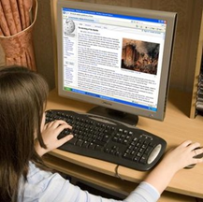

Overview
Applied Research on the importance of reading medium
Current context
Issues from reviews/meta-analyses
Results from our studies with students at different educational levels

Slide 3


Current Context
Advantages of digital textbooks
Covid-19 pandemic →
worldwide shift toward digital learning!
Printed texts increasingly replaced by digital versions
immediately accessible
more cost-effective
reduced environmental impact
Paper vs. digital
Which reading medium is better for learning?

Slide 4



Current Context
National and International reading comprehension tests are administred digitally: PIRLS, PISA, and INVALSI
Notes:
,

Slide 5
Background
Reading is an universal task.
Comprehension of what we read is fundamental for learning, entertainment, adjustment, and survival.
Cognitive process of constructing meaning of text.
Higher-level cognitive process
operating on the outcomes of lower-level processes:
decoding / word recognition
sentences syntactic parsing

Slide 6
Reading comprehension (Kintsch, 1998)
Background
A mental representation that includes elements that were stated explicitly in the text (bottom-up) and inferences that resulted from the activation of prior knowledge (top-down).
Inferences are necessary because no text is fully explicit.
Text-base Model
Connected network of propositions derived from text
Situation Model
Text-derived propositions integrated with prior knowledge

Slide 7



Background
Does the reading medium affect
text comprehension?

Slide 8
Background
Meta-analyses:
Kong et al. (2018 – 17 studies): paper > screen
Delgado et al. (2018 – 54 studies ): paper > screen for comprehension of expository text and under limited time frames
Clinton et al. (2019 – 33 studies): paper > screen for comprehension of expository text and meta-comprehension (calibration)
Research is mainly based on data regarding university and
high-school students

Slide 9

Why is text comprehension better when reading on paper?
Shallowing hypothesis (Annisette & Lafreniere, 2017):
daily use of digital devices characterized by frequent multitasking and rapid interactions promotes a more superficial and incomplete processing of information.
Such processing negatively affects reading comprehension as this cognitive activity requires focused attention for an extended period of time.

Slide 10
Why is text comprehension better when reading on paper?
Familiarity hypothesis (Chen et al., 2014): familiarity with the digital medium reduces cognitive load during reading.
More resources are available for demanding inferential processes.

Slide 11
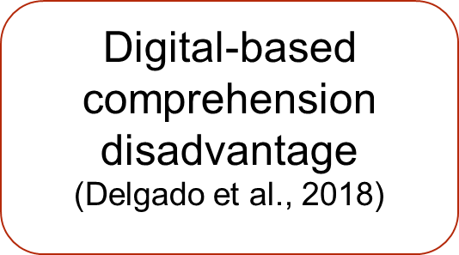
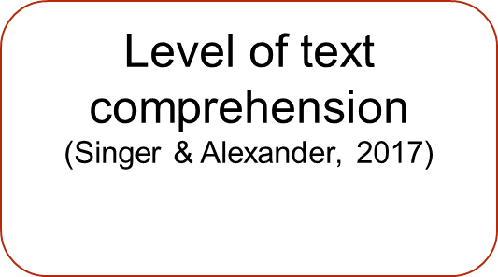
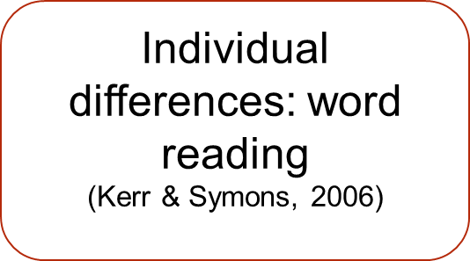
Medium
Task
Reader

Slide 12
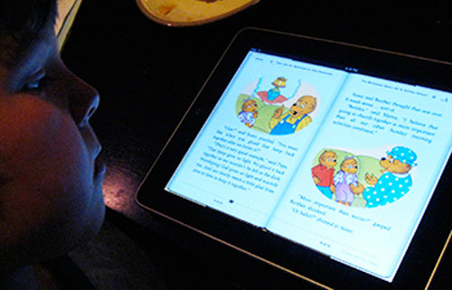
Study 1
First graders
Reading on paper and screen in beginner readers
(Florit et al., 2023)

Slide 13


Open issue
Would comprehension performance when reading on screen also emerge in digital natives -beginner readers- who started using digital devices not only for leisure but also for educational purposes, including learning to read?
What about the contribution of word-reading skills?

Slide 14

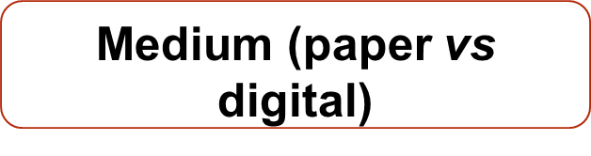


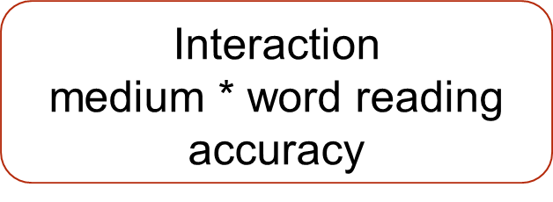

Theoretical Framework
To Investigate
Main point
Reading comprehension in beginner readers
Literal comprehension
Inferential comprehension

Slide 15


Method
Participants
115 children in grade 1 (F= 58%; Mean_{age} = 6.8)
High use of techonology for learning at school
(7-13 hours)
No language difficulties in Italian

Slide 16
Method
Measures
Text comprehension: 7 multiple-choice questions about each text:
1 question: main idea
3 questions: literal comprehension
3 questions: inferential comprehension
Word Reading Accuracy (DDE-2; Sartori et al., 2007)

Slide 17
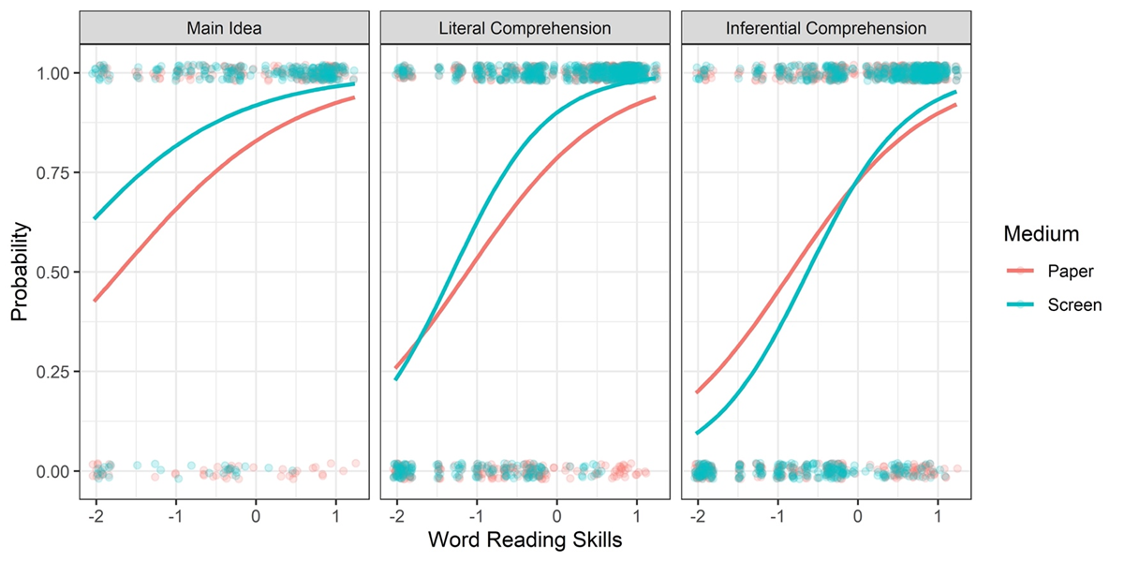
Results
Effects of Reading Medium, Word Reading Skills, and Their Interaction on the Different Levels of Reading Comprehension
Notes:
17
17
17

Slide 18
Discussion
The study shows that a comprehension disadvantage for reading on screen is not evident in beginner readers who use computers for learning activities and are relatively fast and accurate in word reading.

Slide 19
Discussion
No alignment with findings for older students (Clinton, 2019; Delgado et al., 2018). However, the results suggest that when an advantage for reading on screen is evident, this is more at a superficial than at a deeper level of comprehension (Singer & Alexander, 2017).
Contribution of word-reading skills differ by medium, being higher on screen than on paper for both literal and inferential comprehension
  Possible explanations:
- reduced perception of the boundaries and the tangibility of digital texts;
- no tactil reading strategies (tracing text lines with a finger).

Slide 20

Study 2
Preschoolers and 1st graders
Short longitudinal study on precursors
(Florit et al. , 2022)

Slide 21

Theoretical Framework
Precursors
Common cognitive precursors
- Working memory
- Inferential skills
(Kim, 2020; Florit et al., 2014; Oakhill & Cain, 2012)
Specific precursors
Basic digital skills
(e.g., using arrows, clicking on icons, etc.; Hahnel et al., 2016; Fajardo et al., 2016)
Word reading skills: stronger influence when reading on screen than on paper (Kerr & Symons, 2006; Florit et al., 2023).
Notes:
Le ricche condotte nell’ambito, hanno anche cercato di individuare quali abilità componenti/precursori spigassero la comprensione e soprattutto la differenza nei due mezzi.
Sebbene non ci sia un modello unitario/condiviso delle abilitò coinvolte nella comprensione di testi presentati su diversi media, è possibile ipotizzare il coinvolgimento di:

Slide 22
Research Questions
(RQ1) Do reading medium (paper vs. screen) and text genre (narrative vs. descriptive) differentiate text comprehension in children at the end of the first year of primary school (T2)?
(RQ2) Do working memory, inference skills, and basic digital skills at the end of preschool (T1) predict text comprehension at the end of the first year of primary school (T2), considering both text genre and reading medium, and controlling for word reading skills?
If differences emerge at T2 for comprehension in relation to reading medium and text genre, are they predicted by the precursors measured at T1?

Slide 23
Method
Participants
N = 63 children at both T1 and T2
Measures
Working memory – T1
Inference generation – T1
Digital skills – T1
- mechanical
- navigation
- symbolic
Word reading – T2
Text comprehension – T2

Slide 24
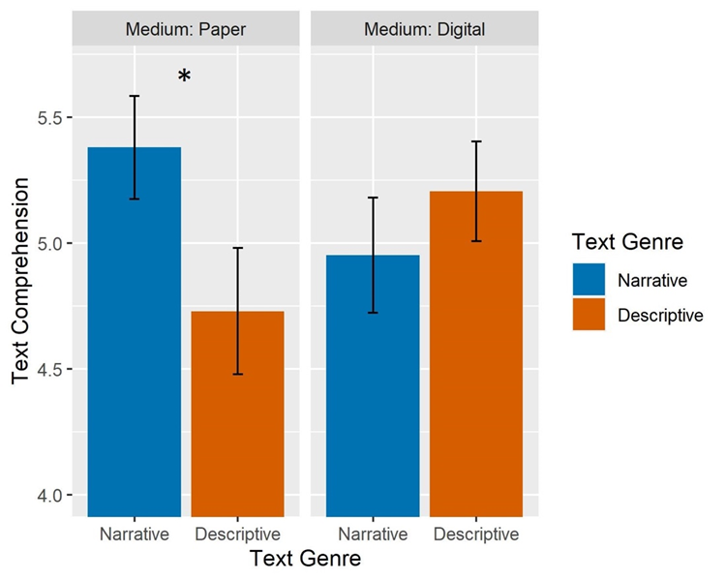
Results
Interaction of Medium and Text Genre on Text Comprehension

Slide 25
Results

Slide 26
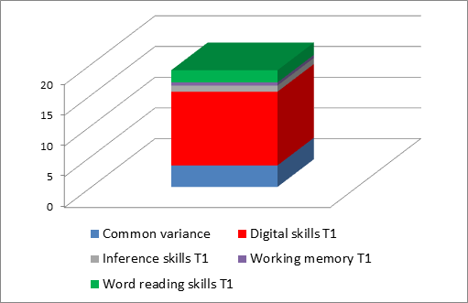
Results
Percentage of Variance for Each Predictor of the Difference Between
Printed and Digital Narrative Text

Slide 27
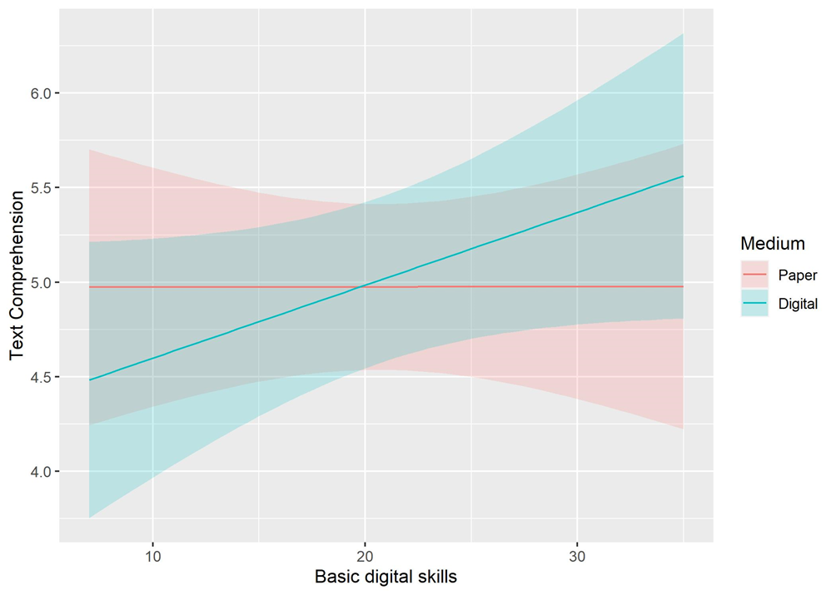
Results
Interaction Between Medium and Basic Digital Skills on Text Comprehension

Slide 28
Discussion
Disadvantage for reading on screen only regards narrative text
comprehension. This is not aligned with the results of meta-analyses
(Delgado et al., 208; Clinton, 2019; Kong et al., 2018) based on
much older students, but aligned with data that the narrative
is the genre children are most exposed to in the first years of schooling.
It is confirmed the importance of digital skills as a resource when reading
online (Fajardo et al., 2016; Neumann et al., 2016), which becomes
even greater in very young readers.
Digital skills must be considered in comprehensive models of emergent
digital literacy.

Slide 29
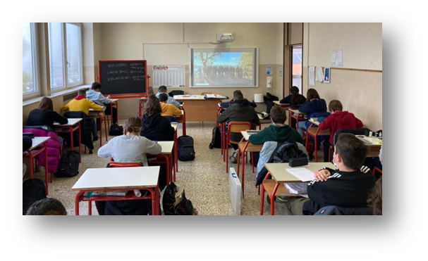

Study 3
8th graders
Text comprehension and meta-comprehension
Ronconi et al., 2022

Slide 30

Why focus on adolescent students?
  Digital devices integral part of their lives
  Use daily digital texts for learning
  Covid19 pandemic → strong impetus toward digital learning
  Increasingly demotivated toward reading → reading on screen perceived as less boring (Dahan Golan et al., 2018; Singer & Alexander, 2017)
Few studies available (Eyre et al., 2017; Goodwin et al., 2020; Simian et al., 2016)
Mostly between-subjects design
Mixed results
No studies on metacomprehension accuracy

Slide 31
Research Questions
Does reading medium (printed vs. digital text) affect secondary school students’
General aim
calibration of performance?
reading time?
To investigate the effects of reading medium on behavioral engagement, conceptual learning and metacomprehension when reading a long expository text.
perception of cognitive load ?
transfer of knowledge?
text comprehension?

Slide 32
Method
Participants
150 eighth graders (60% females; M_{age} = 13.5, SD = 0.43) in eight classes from four urban lower secondary schools in northern Italy.
Texts
Two informational texts: one about phobias, the other about stress.
Design
Within-subjects: each participant read both texts, one on paper and the other on a tablet (text in one screen), in a counterbalanced order.

Slide 33
Method
Dependent variables
Reading time
Text comprehension (open-ended questions)
- main idea
- key points
- other relevant information
Calibration bias (inaccuracy between self-evaluation of comprehension performance and actual performance
.

Slide 34

Control variables
Gender
Working memory
Reading comprehension ability
Topic knowledge
Topic interest

Slide 35
Results
Interaction Effect of Reading Medium and Gender on Reading Time.
Notes:
35

Slide 36
Results
Interaction Effect of Reading Medium and Gender on Calibration Bias.
Notes:
36

Slide 37
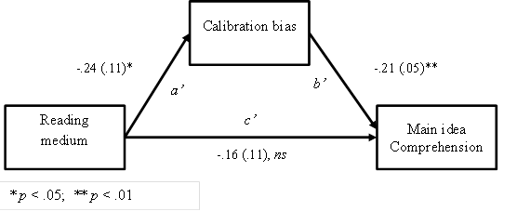
Results
Calibration Bias as Negative Mediator of the Effect of Medium on Comprehension of Main Idea.
Notes:
37

Slide 38
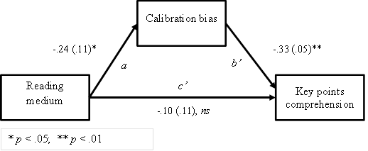
Results
Calibration Bias as Negative Mediator of the Effect of Medium on Comprehension of Key Points.
Notes:
38

Slide 39
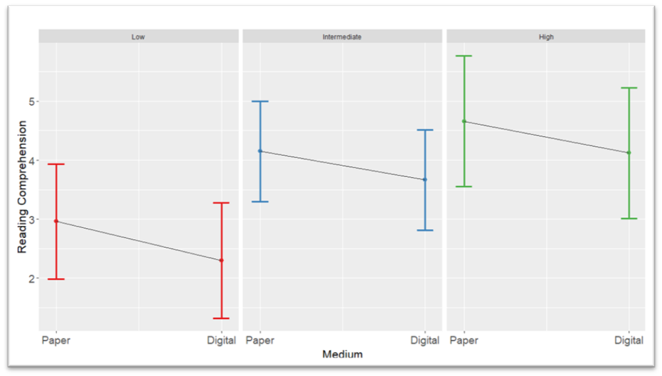
When considering different levels of reading comprehension and medium
Overall, better comprehension when reading on paper, regardless of levels of comprehension.

Slide 40
Discussion
Adolescent students’ deeper comprehension is greater when reading
expository texts in print than when reading digitally.
This outcome is accompanied by higher metacognitive calibration bias for
reading on screen compared to reading on paper.
Calibration bias negatively mediates the effect of reading medium on
comprehension performance.

Slide 41

Study 4
7th and 8th graders
Highlighting for text comprehension and meta-comprehension
Ronconi et al., 2023

Slide 42
Research Questions
Do highlighting and medium affect secondary school students’
General aim
reading time?
To investigate the effects of the simplest and technically easiest reading strategy: highlighting when reading a long expository text.
calibration of performance?
perception of cognitive load ?
text comprehension?

Slide 43
Method
Participants
152 seventh graders (F = 86, M_{age} = 12.39) from two urban lower secondary schools in northern Italy.
Texts
Two informational texts: one about volcanoes, the other about earthquakes.
Design
Within-subjects: each participant read both texts, one on paper and the other on a computer, in a counterbalanced order

Slide 44
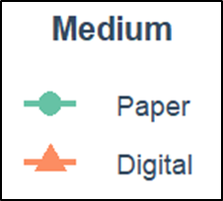
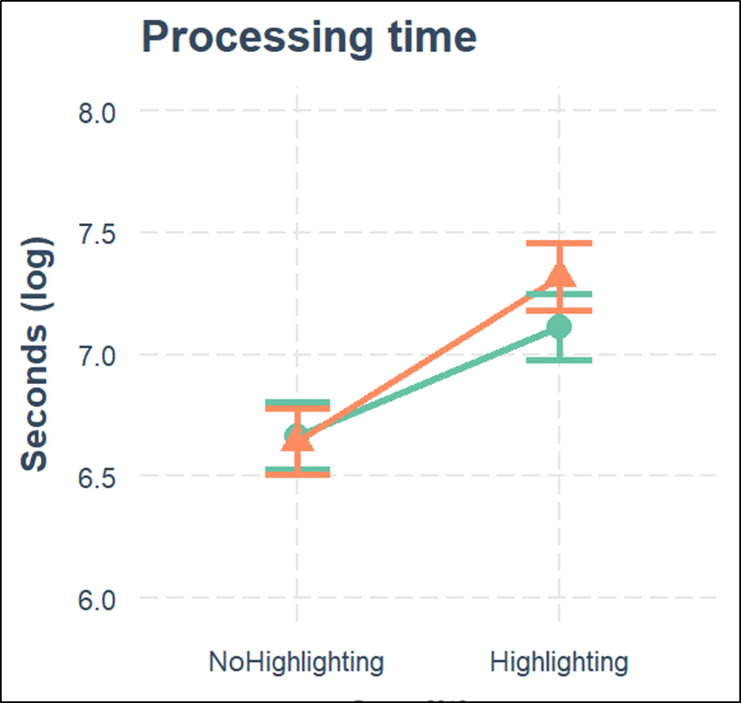
Results
Processing Time by Highlighting and Reading Medium.
Notes:
44

Slide 45
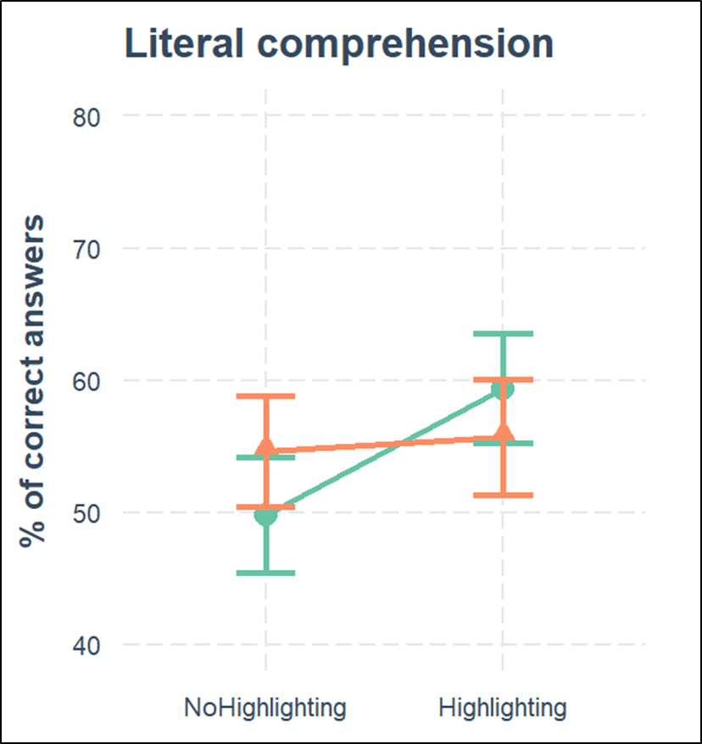
Results
Literal Comprehension by Highlighting and Reading Medium.
Notes:
45

Slide 46
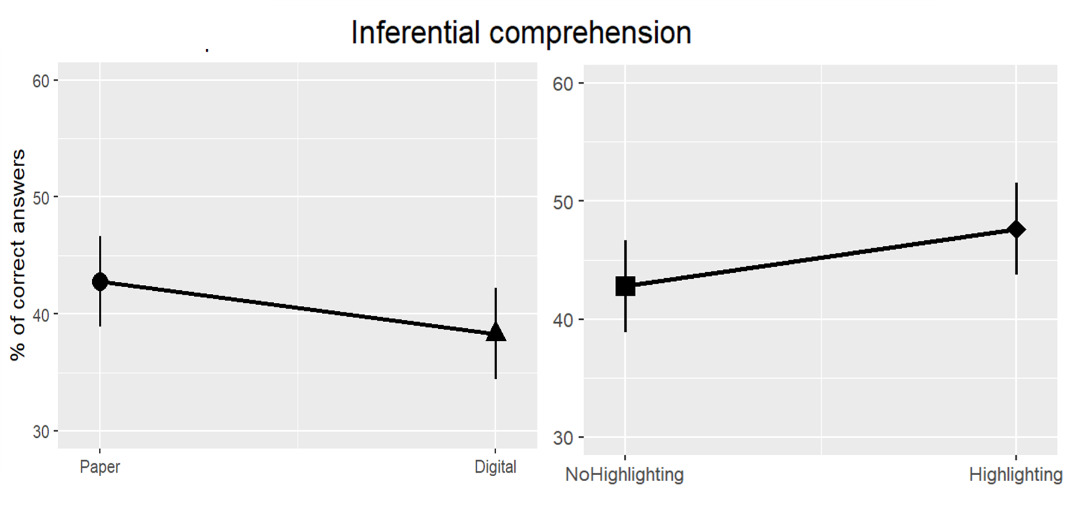
Results
Inferential Comprehension by Reading Medium (Left) and Highlighting (Right).
Notes:
46

Slide 47
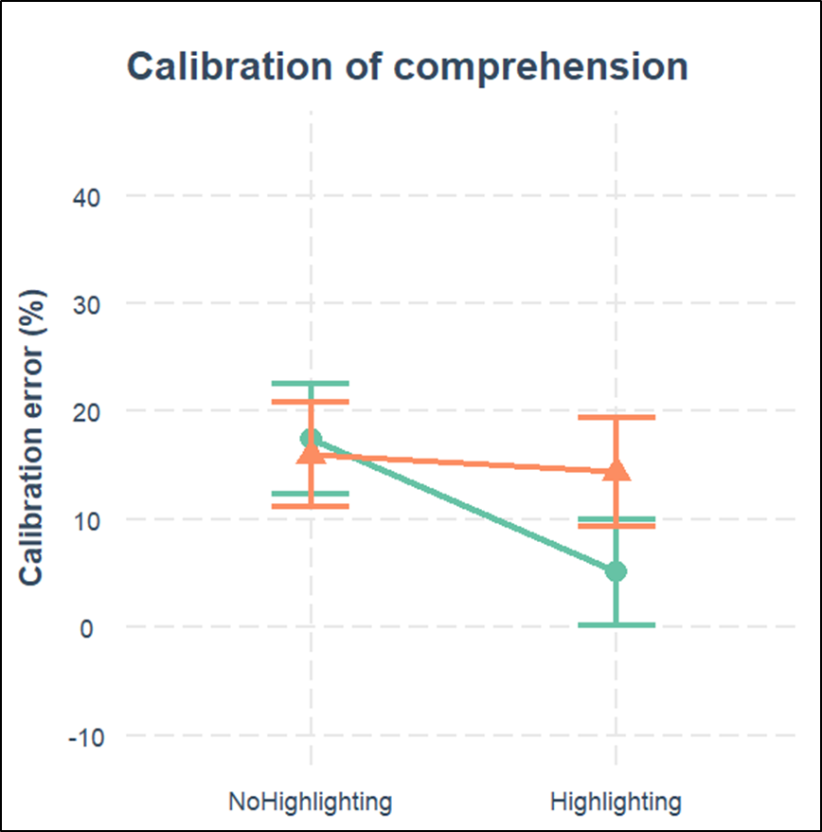
Results
Calibration bias by Highlighting and Reading Medium.
Notes:
47

Slide 48
  Conclusions
  Provide readers with opportunities to make sense of reading
  in digital environments.
  Such opportunities should lead young readers to start
developing metacognitive awareness of what digital reading
requires as compared to traditional reading.
  In-depth understanding of the effects of reading medium should
  consider
- a wide range of grade levels
- cold and warm individual differences
- contextual factors

Slide 49

Florit, E. De Carli, P., Lavelli, E., & Mason, L. (2022). Digital reading in beginner readers: advantage or disadvantage for comprehension of narrative and informational linear texts? Journal of computer Assisted Learning. https://doi.org/10.1111/jcal.12754
Florit, E., De Carli, P., Rodà, A., Domenicale, S., & Mason, L. (2022). Precursors of Reading text comprehension from paper and screen in first graders:
A longitudinal study. Reading and Writing, https://doi.org/10.1007/s11145-022-10327-w
Ronconi, A., Veronesi, V., Mason, L., Manzione, L., Florit, E., Anmarkrud, Ø., & Bråten, I. (2022). Effects of reading medium on the processing, comprehension, and calibration of adolescent readers. Computers & Education, 185. Article 104520 https://doi.org/10.1016/j.compedu.2022.104520
Ronconi, A., Camcagnì, A., & Mason, L. (2023). highlighting in printed and digital reading effects on reading time, text comprehension, and metacognitive calibration of comprehension. Paper presented at the conference of the Society for Text and Discourse (ST&D), Oslo, June 28-30.

Slide 50




Thanks
Angelica Ronconi
Ivar Bräten
Elena Florit
Pietro De Carli
Notes:
50

Slide 51

Notes:
51

